Slide 1
6/1 updates: Finding country exclusive crypto
Cryptos are designed to be accessed globally without being restricted to a specific country or region
utilize blockchain technology that allows for secure and transparent transactions. These digital assets are designed to be fungible and transferable across the internet
cryptocurrency exchanges operate globally
some cryptocurrencies may have gained prominence in specific countries, they are not exclusively used within those regions. Cryptocurrencies are designed to be accessible globally, and users from various countries can transact with them.
cryptocurrencies that exclusively exist in only one country
ex. Petro (PTR) – Venezuela
according to Investopedia, The petro is not traded internationally, so it cannot be purchased through mainstream cryptocurrency exchanges.
price: https://www.coinbase.com/price/petro
ex. Auroracoin – Iceland
created in Iceland
was exclusive in Iceland. but Most Icelanders sold their Auroracoin as fast as possible to get Bitcoin. https://privacypros.io/crypto-scams/
seems to be tradable globally now
there are also CBDC, central bank digital currency (government backed digital currency)
ex. Ditigal Yuan (China) and eNaira (Nigeria)
not cryptocurrency

Slide 2
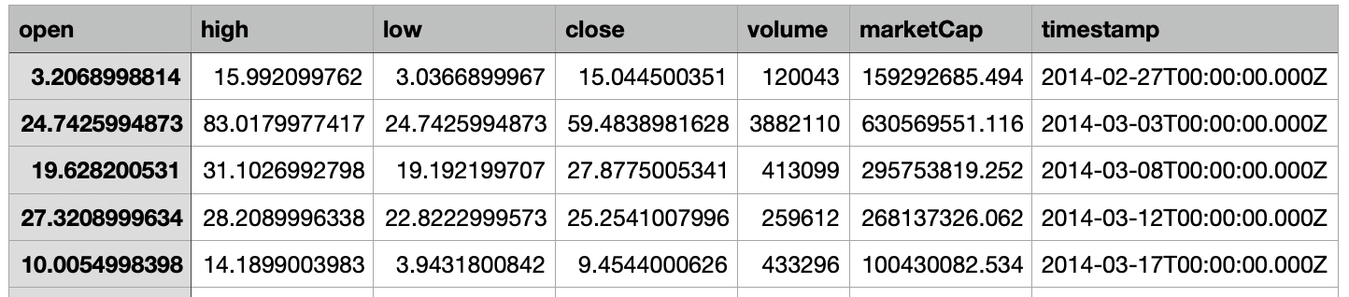
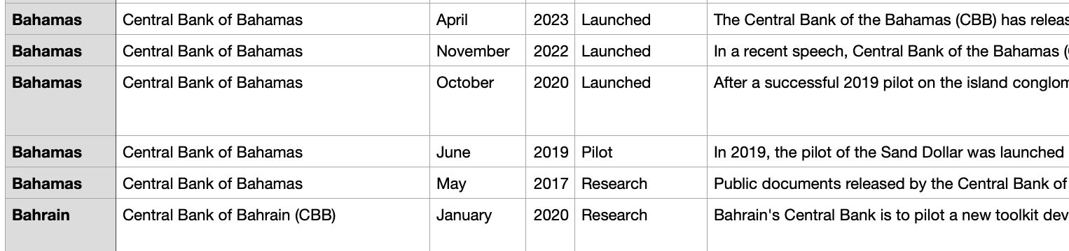
6/8 updates
price and volume for the two cryptos
Petro(PTR) -- Venezuela
volume
The petro's pre-sale started on 20 February 2018 and ended on 19 March 2018 where 38.4 million tokens were made available
The government stated the pre-sale raised US$3.3 billion,^{[15]} though according to Steve Hanke no independent audits were made to verify this claim.^{[16]}
85.94 dollar/token
The second phase of the Petro launch involves a public sale of 44 million tokens.
44 million Petros will be sold to bring in an estimated additional $2.4 billion
54.55 dollar/token
price -- only available for price after 6/11/2021
https://www.coinbase.com/price/petro
Auroracoin -- Iceland
price & volume
https://coinmarketcap.com/currencies/auroracoin/
all CBDC and their timelines
https://cbdctracker.org/
https://github.com/liquifi-org/cbdc-tracker
found the data in telegram chat

Slide 3
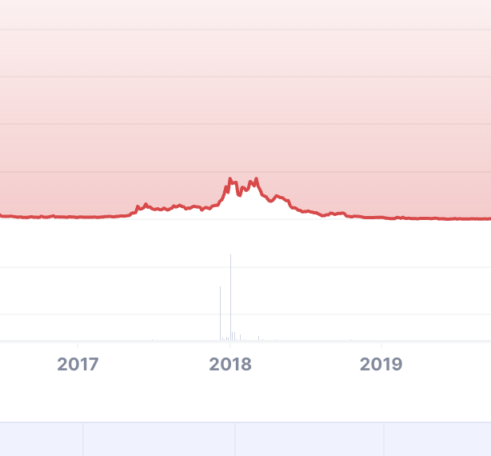
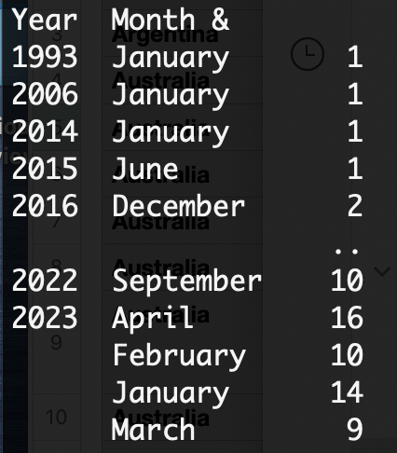
6/15
Auroracoin & Iceland crypto policy
According to a 2014 opinion, from the Central Bank of Iceland "there is no authorization to purchase foreign currency from financial institutions in Iceland or to transfer foreign currency across borders on the basis of transactions with virtual currency. For this reason alone, transactions with virtual currency are subject to restrictions in Iceland."^{[173]}
On 12 March 2017, the Central Bank amended its rules. With the new rules, wide and general exemptions have been granted from the restrictions of the Foreign Exchange Act
There was an increase in price for Auroracoin starting in 05/2017 ($0.2), reaching highest point in 3/2018 ($2), and decreased to $0.01 in 12/2018.
CBDC's status vs Crypto Price
examined the dataset
Government released news on CBDC, 328 news in 107 countries
8 launches, 187 researches, 44 pilots, 77 proof of concept, 12 cancelled
ideas
group by year and month, examine relationship between the number of official CBDC news from government for each month vs. crypto price change in that month
[1, 1, 1, 1, 2, 1, 1, 1, 3, 2, 2, 1, 2, 2, 1, 1, 1, 1, 2, 2, 2, 1, 1, 4, 2, 1, 2, 1, 2, 5, 3, 2, 1, 2, 2, 4, 1, 1, 1, 2, 4, 5, 2, 6, 5, 9, 1, 4, 9, 1, 10, 1, 4, 1, 8, 9, 1, 5, 5, 1, 9, 15, 7, 16, 3, 9, 11, 8, 1, 2, 9, 19, 10, 16, 10, 14, 9]

Slide 4
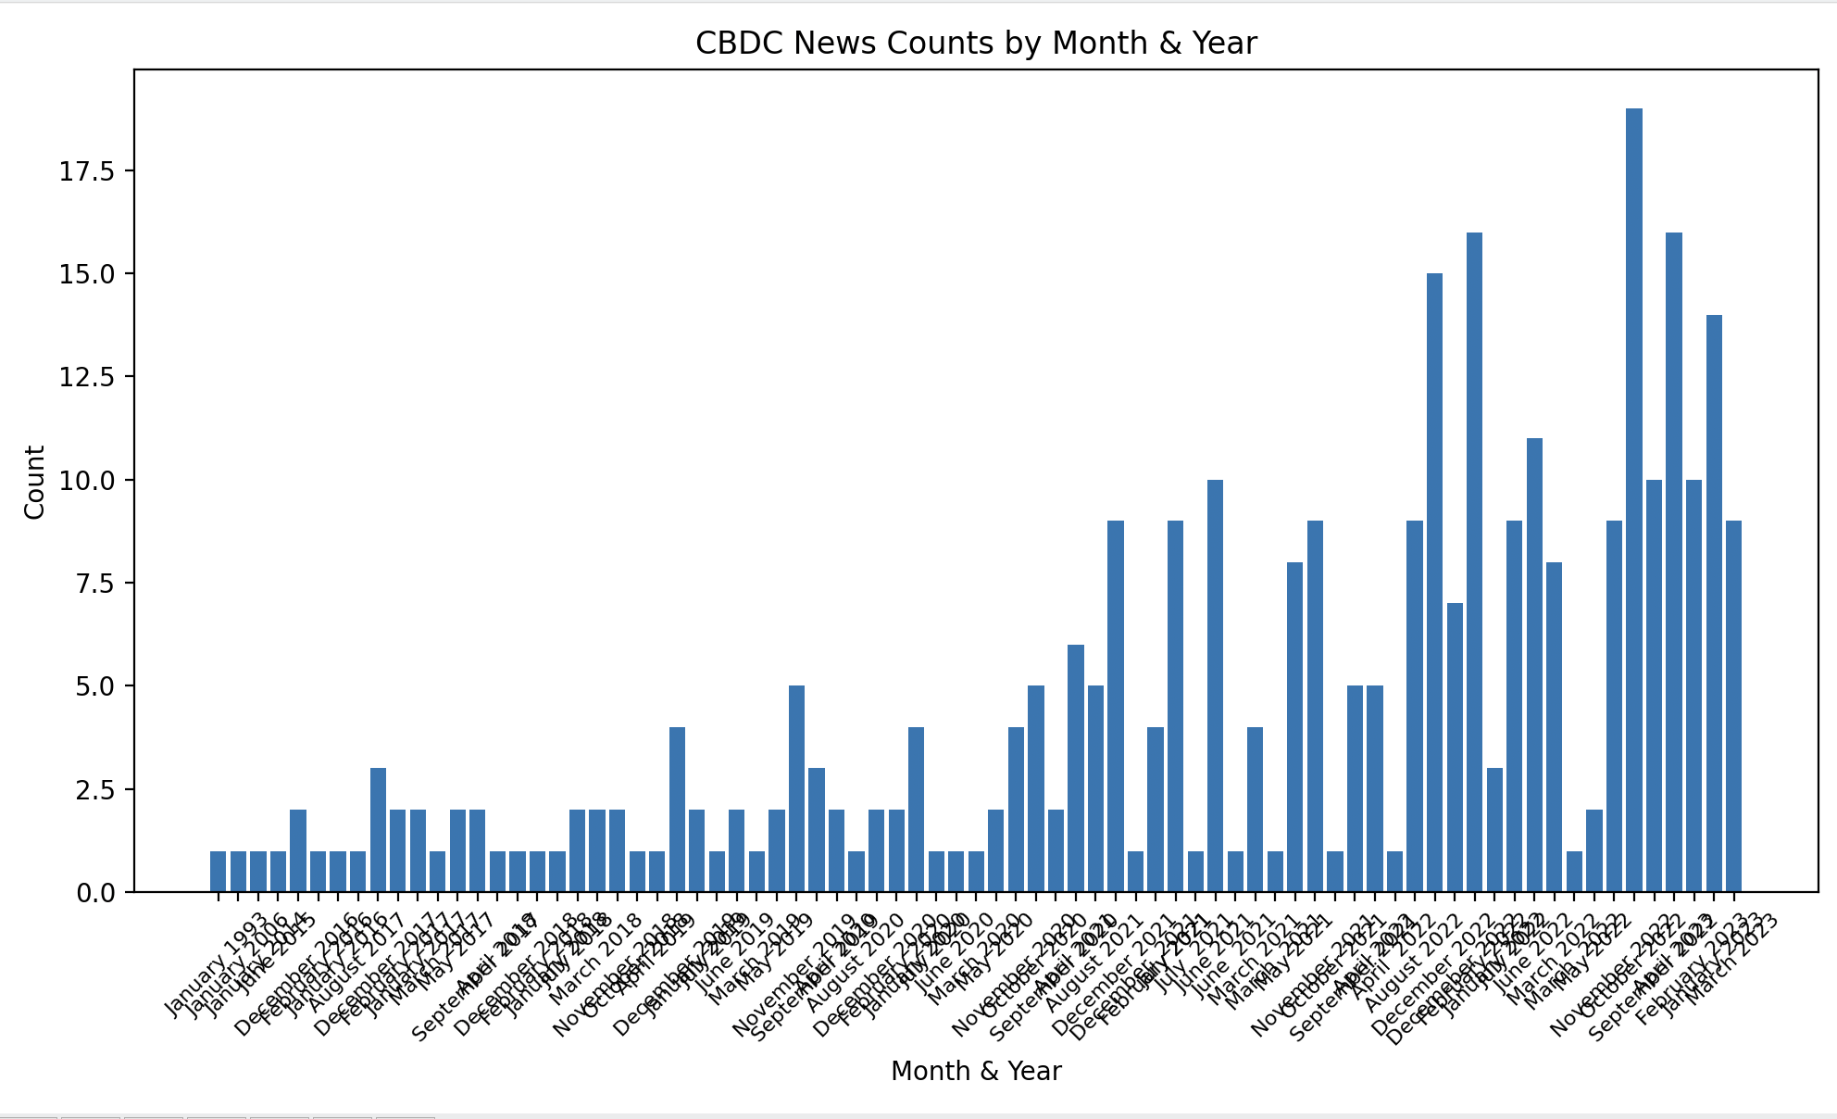
7/27
Central Backed Digital Currency Data
https://cbdctracker.org/
https://github.com/liquifi-org/cbdc-tracker
Will work on Crytpo data, see how CBDC in each country
affects crypto price

Slide 5
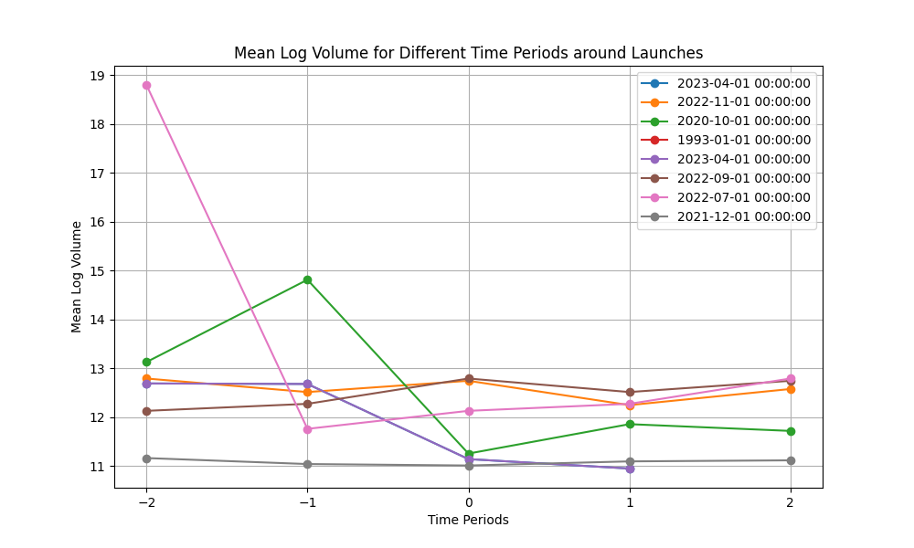
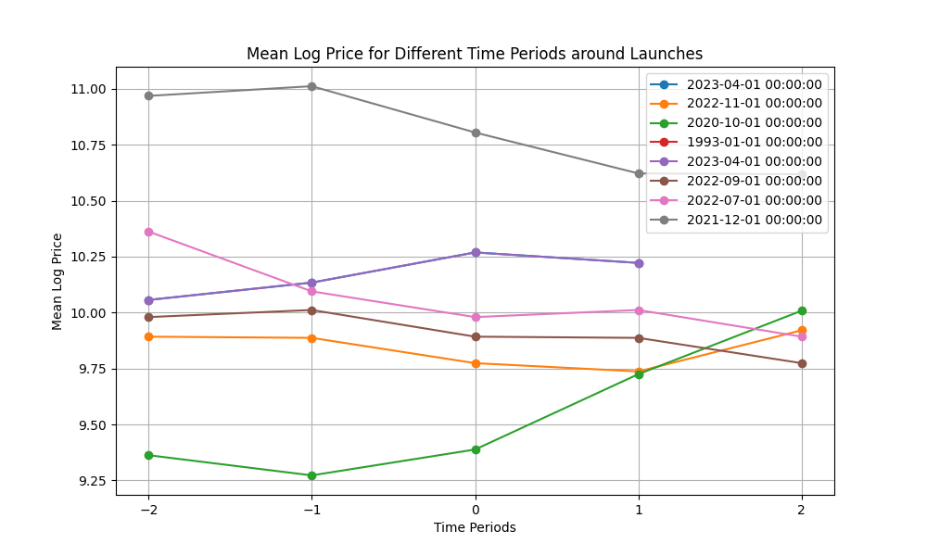
8/9
I examined the crypto price and volume 2 months, 1 month, the month of, 1 month after, and 2 months after the launches of Central Backed Digital Currencies. I have attached the visualization to the email.
There are in total 8 CBDC launches according to this dataset, and I am very sad to see that there is no obvious trend or pattern that is shared among all the 8 CBDC launches. However, the trading volume of crypto seems to decrease around 3 CBDC launches. This might indicate that people are switching to CBDC, therefore, trading less crypto. However, I think the sample size is relatively small to draw a significant conclusion.

Slide 6
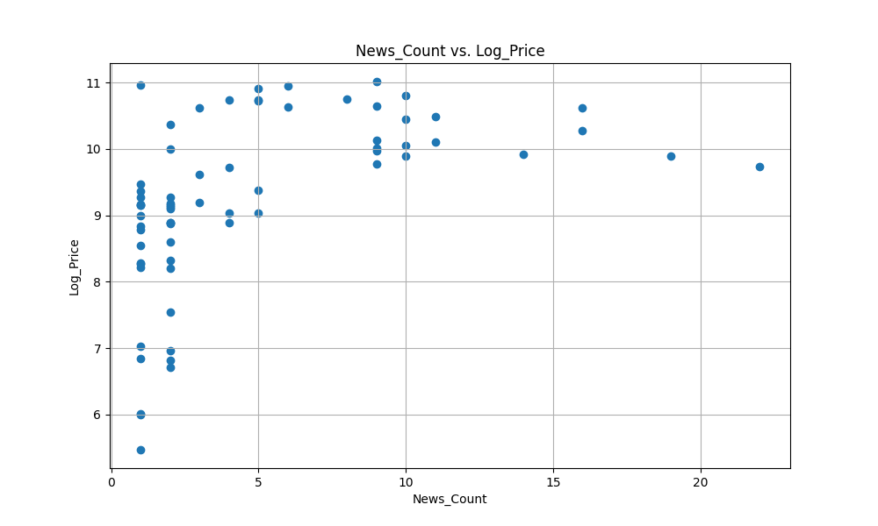
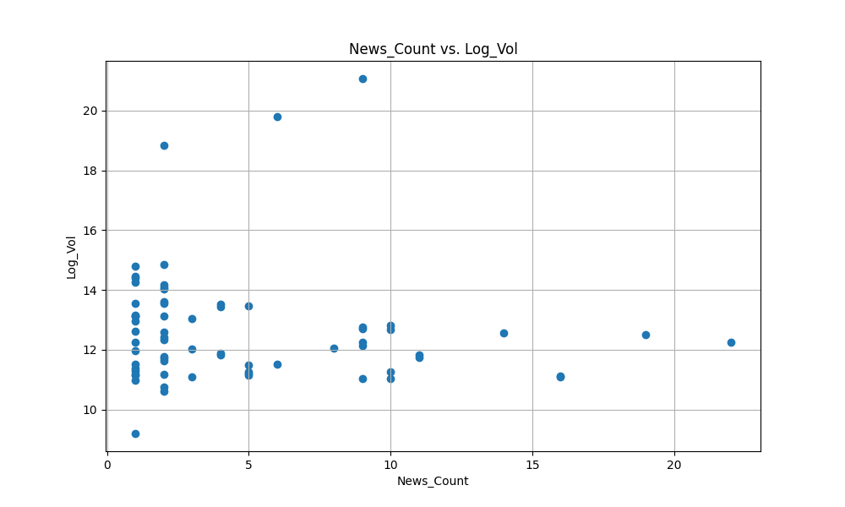
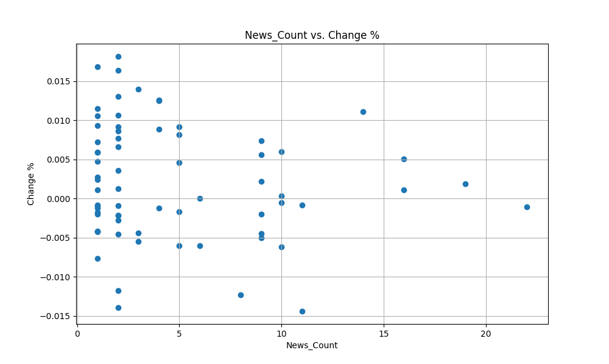
8/17
examined the relationship between number of cbdc news vs log price, log volume, and percentage price change -- no obvious correlation

Slide 7
8/25
Crypto Legality Policy
Average Slope for Log Price (Legal Status: Legal): 0.002469692150133813
Average Slope for Log Price (Legal Status: Illegal): -0.002455981990060988
Average Slope for Log Volume (Legal Status: Legal): 0.01260757503698833
Average Slope for Log Volume (Legal Status: Illegal): 0.06501841553720902
The following slides are crypto prices around each legal status change.

Slide 8
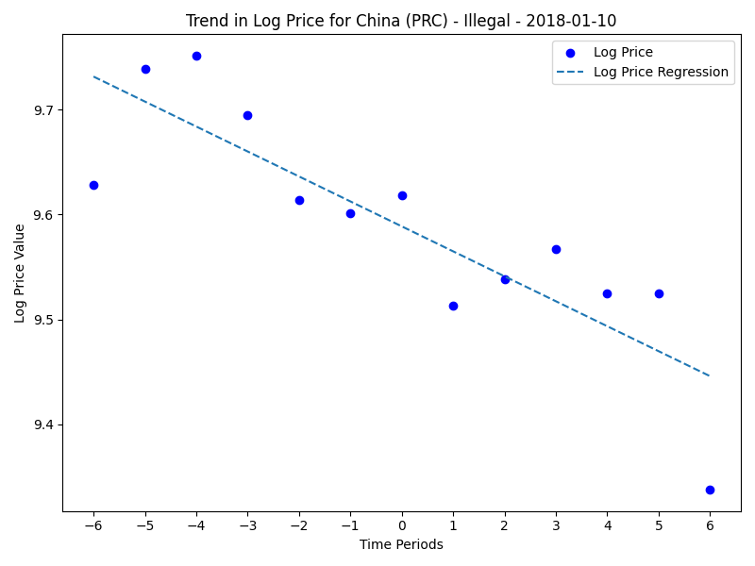
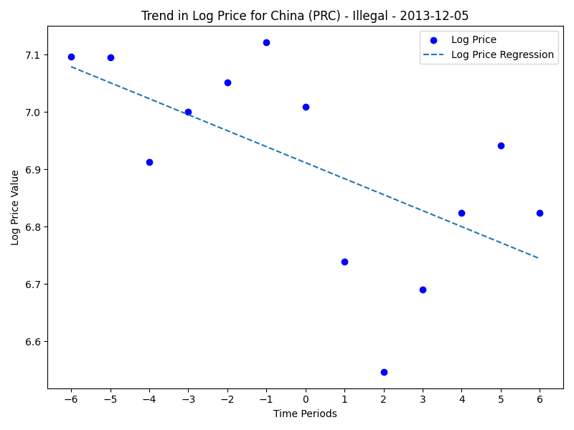
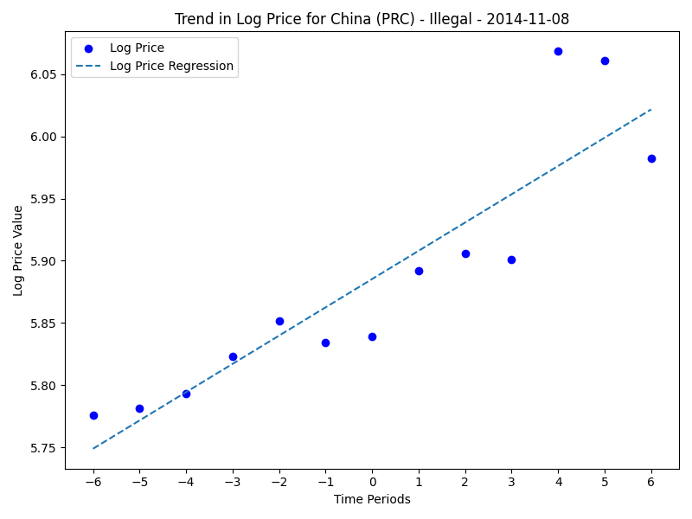
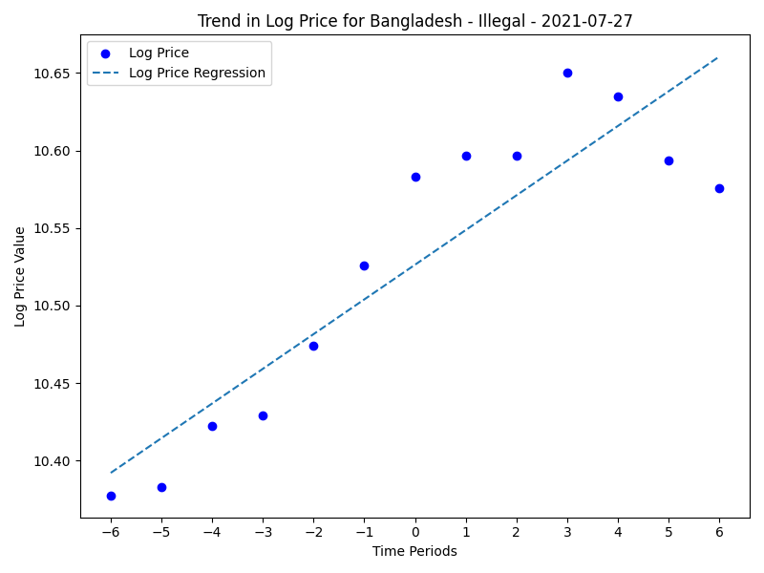
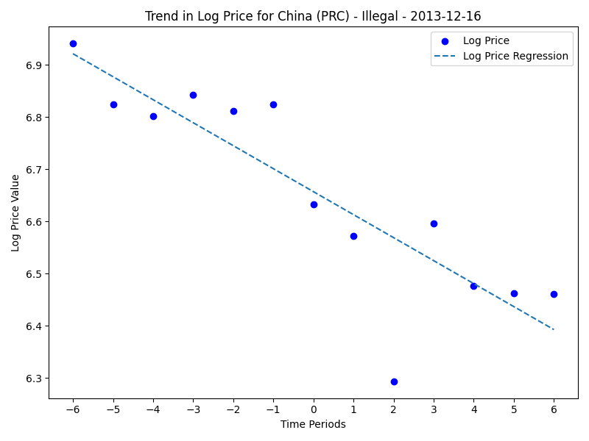
price change when country declared illegal

Slide 9
Corresponding news
On 5 December 2013, a proposal was put forth by 45 members of the Swiss Parliament for digital sustainability (Pardigli), that calls on the Swiss government to evaluate the opportunities for utilization of bitcoin by the country's financial sector.[146] It also seeks clarification on bitcoin's legal standing with respect to VAT, securities and anti-money laundering laws.
Financial institutions are not allowed to facilitate bitcoin transactions.[14] Regulation prohibits financial firms holding or trading cryptocurrencies.[8]: China On 5 December 2013, People's Bank of China (PBOC) made its first step in regulating bitcoin by prohibiting financial institutions from handling bitcoin transactions.[98] On 1 April 2014 PBOC ordered commercial banks and payment companies to close bitcoin trading accounts in two weeks.[99] Cryptocurrency exchanges or trading platforms were effectively banned by regulation in September 2017 with 173 platforms closed down by July 2018.[100] In early 2018 the People's Bank of China announced the State Administration of Foreign Exchange led by Pan Gongsheng would crack down on bitcoin mining.[101][102] Many bitcoin mining operations in China had stopped operating by January 2018.[100] A complete ban on cryptocurrency trading and mining was put into effect on 24 September 2021.[103]
Financial institutions are not allowed to facilitate bitcoin transactions.[14] Regulation prohibits financial firms holding or trading cryptocurrencies.[8]: China On 5 December 2013, People's Bank of China (PBOC) made its first step in regulating bitcoin by prohibiting financial institutions from handling bitcoin transactions.[98] On 1 April 2014 PBOC ordered commercial banks and payment companies to close bitcoin trading accounts in two weeks.[99] Cryptocurrency exchanges or trading platforms were effectively banned by regulation in September 2017 with 173 platforms closed down by July 2018.[100] In early 2018 the People's Bank of China announced the State Administration of Foreign Exchange led by Pan Gongsheng would crack down on bitcoin mining.[101][102] Many bitcoin mining operations in China had stopped operating by January 2018.[100] A complete ban on cryptocurrency trading and mining was put into effect on 24 September 2021.[103]
Text doesn’t mention the date
2014-11-08 – Date entry error
Financial institutions are not allowed to facilitate bitcoin transactions.[14] Regulation prohibits financial firms holding or trading cryptocurrencies.[8]: China On 5 December 2013, People's Bank of China (PBOC) made its first step in regulating bitcoin by prohibiting financial institutions from handling bitcoin transactions.[98] On 1 April 2014 PBOC ordered commercial banks and payment companies to close bitcoin trading accounts in two weeks.[99] Cryptocurrency exchanges or trading platforms were effectively banned by regulation in September 2017 with 173 platforms closed down by July 2018.[100] In early 2018 the People's Bank of China announced the State Administration of Foreign Exchange led by Pan Gongsheng would crack down on bitcoin mining.[101][102] Many bitcoin mining operations in China had stopped operating by January 2018.[100] A complete ban on cryptocurrency trading and mining was put into effect on 24 September 2021.[103]
Financial institutions are not allowed to facilitate bitcoin transactions.[14] In September 2014, Bangladesh Bank said that "anybody caught using the virtual currency could be jailed under the country's strict anti-money laundering laws".[78] In 2021 the Bangladesh Bank said that cryptocurrency transactions or trade should be deemed as crimes if they involve money laundering or terror financing.[79]
Financial institutions are not allowed to facilitate bitcoin transactions.[14] Regulation prohibits financial firms holding or trading cryptocurrencies.[8]: China On 5 December 2013, People's Bank of China (PBOC) made its first step in regulating bitcoin by prohibiting financial institutions from handling bitcoin transactions.[98] On 1 April 2014 PBOC ordered commercial banks and payment companies to close bitcoin trading accounts in two weeks.[99] Cryptocurrency exchanges or trading platforms were effectively banned by regulation in September 2017 with 173 platforms closed down by July 2018.[100] In early 2018 the People's Bank of China announced the State Administration of Foreign Exchange led by Pan Gongsheng would crack down on bitcoin mining.[101][102] Many bitcoin mining operations in China had stopped operating by January 2018.[100] A complete ban on cryptocurrency trading and mining was put into effect on 24 September 2021.[103]
“If they involve money laundering or terror financing” -- not banning the public use, banking ban (wrong label)

Slide 10
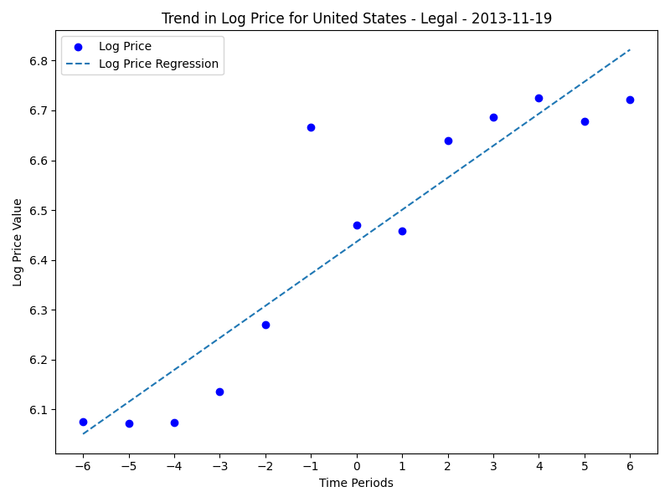
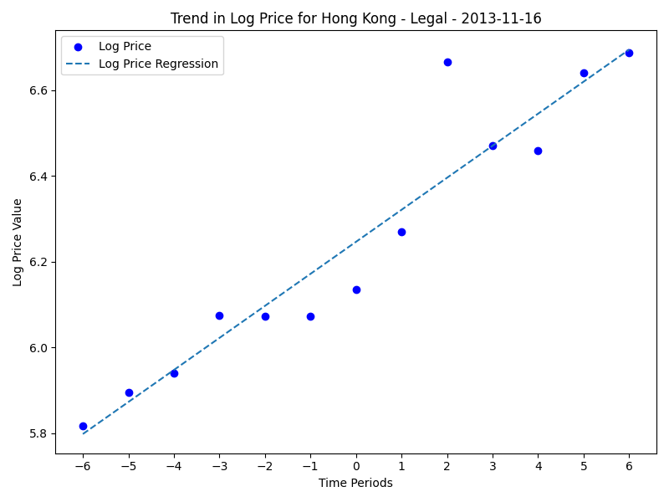
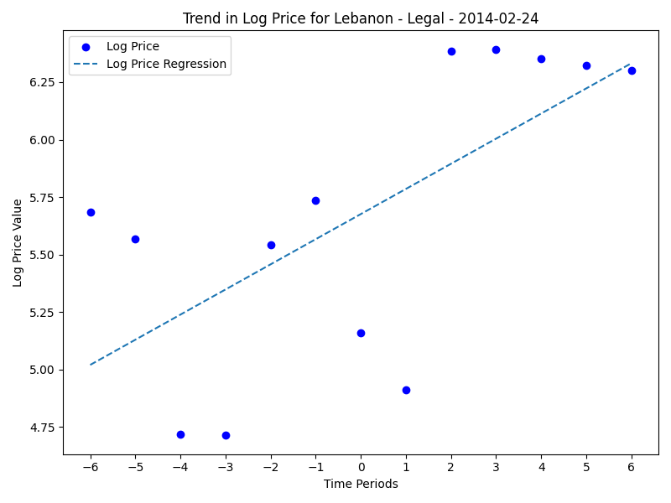
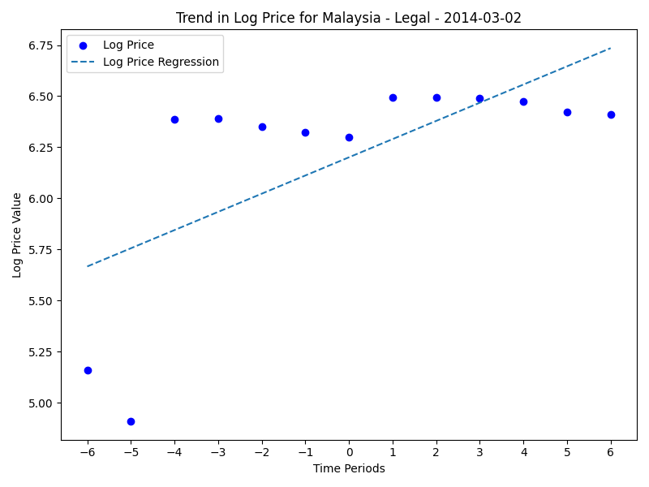
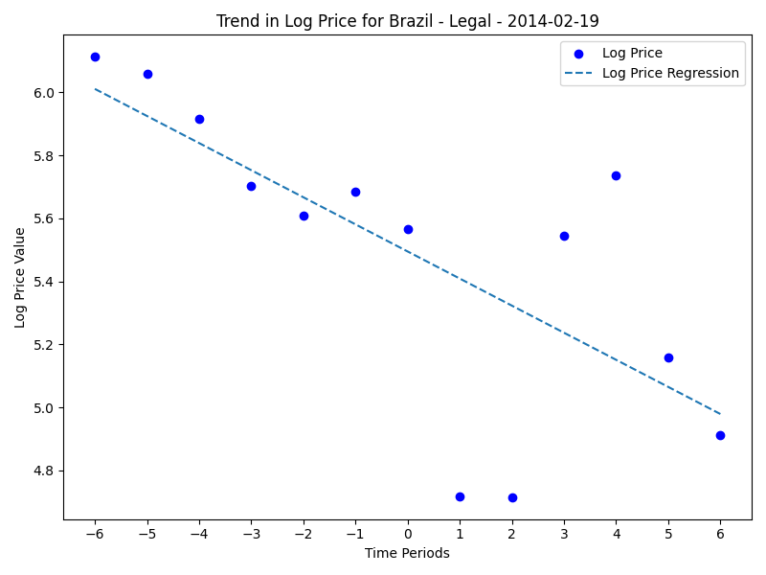

Slide 11
The U.S. Treasury classified bitcoin as a convertible decentralized virtual currency in 2013.[33] The Commodity Futures Trading Commission (CFTC), classified bitcoin as a commodity in September 2015. Per the Internal Revenue Service (IRS), bitcoin is taxed as a property.[34] Bitcoin was mentioned in a U.S. Supreme Court opinion (in the case of Wisconsin Central Ltd. v. United States) on 21 June 2018.[35] In an opinion, the U.S. Supreme Court mentioned that the definition of money has changed over time and that "perhaps one day employees will be paid in Bitcoin or some other type of cryptocurrency..."[35] If money services businesses, including cryptocurrency exchanges, money transmitters, and anonymizing services (known as "mixers" or "tumblers") do a substantial amount of business in the U.S., according to Financial Crimes Enforcement Network (FinCEN) director Kenneth Blanco in 2018, they are required to:[36] register with the U.S. FinCEN as a money services business design and enforce an anti-money laundering (AML) program, and keep appropriate records and make reports to FinCEN, including Suspicious Activity Reports (SARs) and Currency Transaction Reports (CTRs) As of August 2018[update], U.S. FinCEN had been receiving more than 1,500 SARs per month involving cryptocurrencies.[36] Seventeen other countries have similar AML requirements.[14] In September 2016, in a federal court case involving a person operating an unlicensed money transmitting businesses, the U.S. District Court for the Southern District of New York ruled that "Bitcoins are funds within the plain meaning of that term. Bitcoins can be accepted as a payment for goods and services or bought directly from an exchange with a bank account. They therefore function as pecuniary resources and are used as a medium of exchange and a means of payment."[37]
On 8 January 2014, the Secretary for Financial Services and the Treasury addressed bitcoin in the Legislative Council stating that "Hong Kong at present has no legislation directly regulating bitcoins and other virtual currencies of [a] similar kind. However, our existing laws (such as the Organised and Serious Crimes Ordinance) provide sanctions against unlawful acts involving bitcoins, such as fraud or money laundering."[3]: Hong Kong On 16 November 2013, Norman Chan, the chief executive of Hong Kong Monetary Authority (HKMA) said that bitcoin is only a virtual commodity. He also decided that bitcoin will not be regulated by HKMA. However, the authority will be closely watching the usage of bitcoin locally and its development overseas.[104]
The government of Jordan has issued a warning discouraging the use of bitcoin and other similar systems.[71] The Central Bank of Jordan prohibits banks, currency exchanges, financial companies, and payment service companies from dealing in bitcoins or other digital currencies.[72] While it warned the public of risks of bitcoins, and that they are not legal tender, bitcoins are still accepted by small businesses and merchants.[72]
The government of Lebanon has issued a warning discouraging the use of bitcoin and other similar systems.[71]
Unregulated and discuraged
In December 2022, Brazil established a licensing regime for virtual asset service providers with the aim of legalizing crypto as a payment method.[citation needed] Previously regulated, according to a 2014 statement by the Central Bank of Brazil concerning cryptocurrencies, but is discouraged because of operational risks.[51] In November 2017 this unregulated and discouraged status was reiterated by the Central Bank of Brazil.[52] On 7 May 2019, the Special Department of Federal Revenue of Brazil published a document on cryptocurrency taxes in the country.[53]
On 4 November 2013, Bank Negara Malaysia (BNM) met with local bitcoin proponents to learn more about the currency but did not comment at the time.[115] BNM issued a statement on 6 January 2014 that bitcoin is not recognised as a legal tender in Malaysia. The central bank will not regulate bitcoin operations at the moment and users should aware of the risks associated with bitcoin usage.[116][117][3]: Malaysia

Slide 12
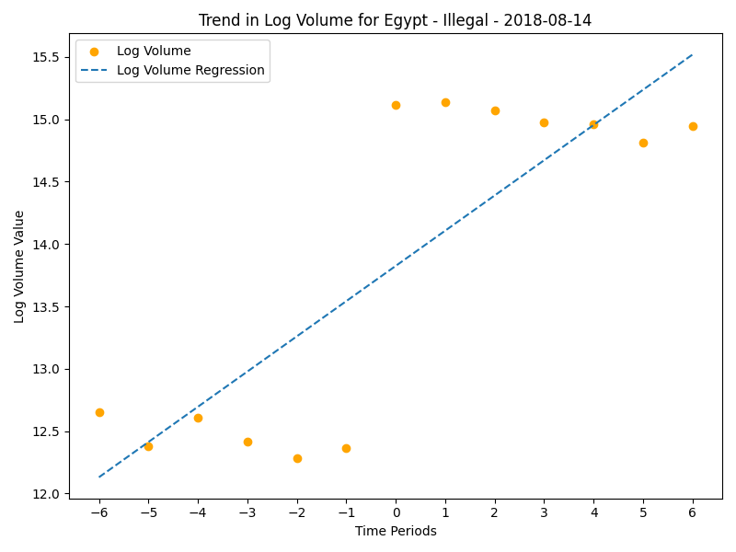
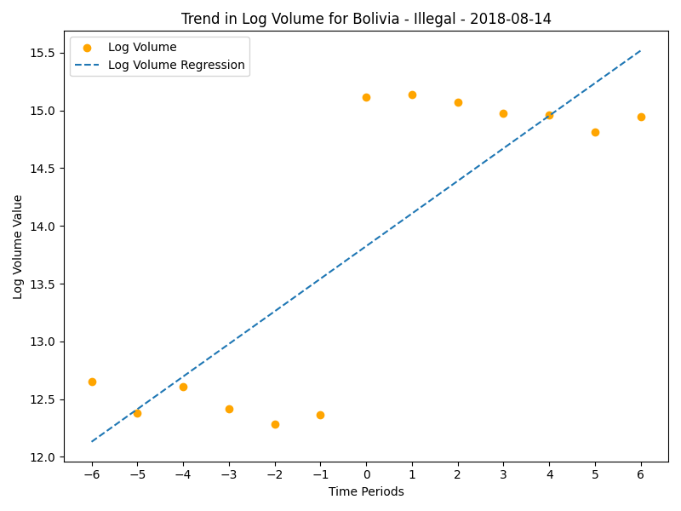

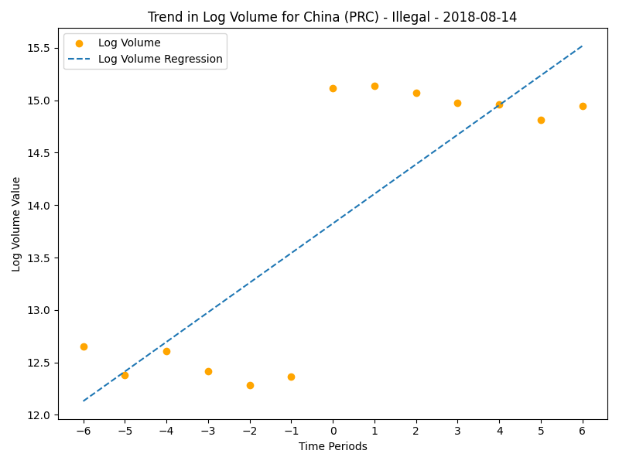
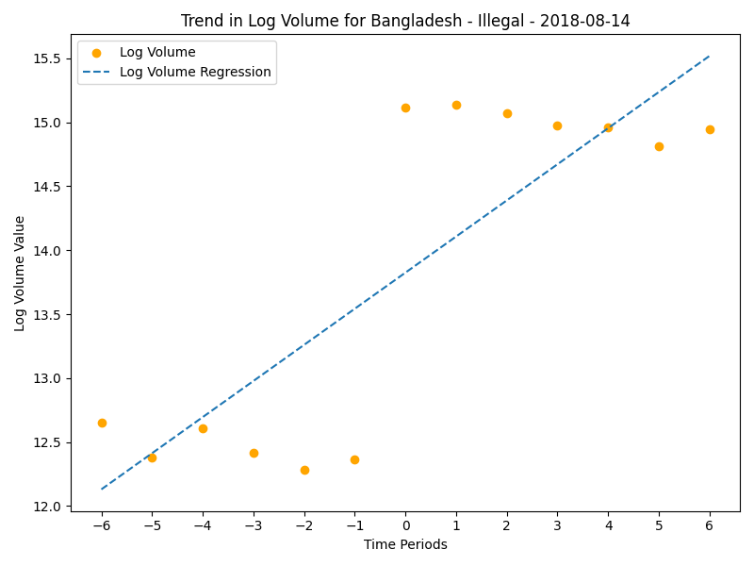

Slide 13
8-14-2018
Legal
Saudi Arabia
Financial institutions are warned from using bitcoin.[14] The Saudi Central Bank (SAMA) has warned from using bitcoin as it is high risk and its dealers will not be guaranteed any protection or rights.[70]
Australia
Not considered to be an official form of currency, earnings are subject to tax law. The Financial Market Authority (FMA) has warned investors that cryptocurrencies are risky and that the FMA does not supervise or regulate virtual currencies, including bitcoin, or cryptocurrency trading platforms.[14]: 30–31
Cambodia
The National Bank of Cambodia (NBC), has "asked banks in Cambodia not to allow people to conduct transactions with cryptocurrencies."[14]
Croatia
Croatia's Financial Stability Council warned investors about the risks of virtual currencies, such as digital wallet theft and fraud, on 18 December 2017. The National Bank of Croatia issued a similar warning on 22 September 2017.[14]: 33
Czech Republic
Businesses and individuals who buy, sell, store, manage, or mediate the purchase or sale of virtual currencies or provide similar services must comply with the anti-money laundering law.[14]: 33–34 Bitcoin is classified as an intangible asset (not as electronic money) for the purpose of accounting and taxes.[129][130]
Germany
On 19 August 2013, the German Finance Ministry announced that bitcoin is now essentially a "unit of account" and can be used for the purpose of tax and trading in the country, meaning that purchases made with it must pay VAT as with euro transactions. It is not classified as a foreign currency or e–money but stands as "private money" which can be used in "multilateral clearing circles", according to the ministry.[131][132] The Bundesbank says that bitcoin is not a virtual currency or digital money. It recommends using the term "crypto token."[14]: 41 In November 2019, a legislation passed by German parliament allows the banks to sell and store cryptocurrencies starting from 1 January 2020.[133]
Indonesia
On 7 December 2017, Bank Indonesia, the country's central bank, issued a regulation banning the use of cryptocurrencies including bitcoin as payment tools starting 1 January 2018.[14] On 11 November 2021, Indonesian Ulema Council issued haram fatwa against use of cryptocurrencies as currency including Bitcoin, citing both Islamic laws and Indonesian banking and monetary regulations. The fatwa also forbids cryptocurrency trading and holding, except if those cryptocurrencies met the Islamic sil'ah standards of trade-able and own-able goods such as having physical form, having clear value, having known number, can be really owned, transferable, and not entirely speculative.[113] By passing of the Law on Financial Sector Development and Strengthening on 15 December 2022, all cryptocurrencies including the Bitcoin listed as "monitored financial technologies" that all related affairs related to the innovation, utilization, and other activities related to it will become the subject of Bank Indonesia and Financial Services Authority control and monitoring.[114]
Iran
Financial institutions are not allowed by central bank to facilitate bitcoin transactions.[14] In April 2018, Central Bank of the Islamic Republic of Iran issued a statement banning the country's banks and financial institutions from dealing with cryptocurrencies, citing money laundering and terrorism financing risks.[77]
Taiwan
Financial institutions are not allowed to facilitate bitcoin transactions.[14] Regulators have warned the public that bitcoin does not have legal protection, "as the currency is not issued by any monetary authority and is therefore not entitled to legal claims or guarantee of conversion".[110] Financial institutions have been warned by regulators that necessary regulatory actions may be taken if they use bitcoin.[3]: Taiwan On 31 December 2013, Financial Supervisory Commission (Republic of China) (FSC) and CBC issued a joint statement which warns against the use of bitcoin. It is stated that bitcoin remains highly volatile, highly speculative, and is not entitled to legal claims or guarantee of conversion.[111] On 5 January 2014, FSC chairman Tseng Ming-chung stated that FSC will not allow the installation of bitcoin ATM in Taiwan because bitcoin is not a currency and it should not be accepted by individuals and banks as payment.[112]
United Arab Emirates
According to the Library of Congress "The Central Bank does not recognize cryptocurrencies as a form of payment yet. However, it is working on a new regulation for retail payment services that introduces the concept of tokens that could be used for payment purposes."[28] On 13 February 2018 Dubai gold trader Regal RA DMCC became the first company in the Middle East to get a license to trade cryptocurrencies, the Dubai Multi Commodities Centre said.[62] DMCC's website emphasizes the "cold storage" of cryptocurrencies and states "DMCC's Crypto-commodities license is for Proprietary Trading in Crypto-commodities only. No initial coin offerings are permitted and no establishment of an exchange is permitted under this license."[63] In November 2020, the Securities and Commodities Authority published "The Chairman of the Authority's Board of Directors' Decision No. (23/Chairman) of 2020 Concerning Crypto Assets Activities Regulation." It establishes a regulatory framework for the offering, issuance, listing, and trading of crypto assets. Crypto assets providers must be incorporated onshore within the UAE.[64][65][66][67]
United States
The U.S. Treasury classified bitcoin as a convertible decentralized virtual currency in 2013.[33] The Commodity Futures Trading Commission (CFTC), classified bitcoin as a commodity in September 2015. Per the Internal Revenue Service (IRS), bitcoin is taxed as a property.[34] Bitcoin was mentioned in a U.S. Supreme Court opinion (in the case of Wisconsin Central Ltd. v. United States) on 21 June 2018.[35] In an opinion, the U.S. Supreme Court mentioned that the definition of money has changed over time and that "perhaps one day employees will be paid in Bitcoin or some other type of cryptocurrency..."[35] If money services businesses, including cryptocurrency exchanges, money transmitters, and anonymizing services (known as "mixers" or "tumblers") do a substantial amount of business in the U.S., according to Financial Crimes Enforcement Network (FinCEN) director Kenneth Blanco in 2018, they are required to:[36] register with the U.S. FinCEN as a money services business design and enforce an anti-money laundering (AML) program, and keep appropriate records and make reports to FinCEN, including Suspicious Activity Reports (SARs) and Currency Transaction Reports (CTRs) As of August 2018[update], U.S. FinCEN had been receiving more than 1,500 SARs per month involving cryptocurrencies.[36] Seventeen other countries have similar AML requirements.[14] In September 2016, in a federal court case involving a person operating an unlicensed money transmitting businesses, the U.S. District Court for the Southern District of New York ruled that "Bitcoins are funds within the plain meaning of that term. Bitcoins can be accepted as a payment for goods and services or bought directly from an exchange with a bank account. They therefore function as pecuniary resources and are used as a medium of exchange and a means of payment."[37]
Illegal
Algeria
According to the "Journal Officiel" (28 December 2017): Art. 117. — The purchase, sale, use, and holding of so-called virtual currency is prohibited. Virtual currency is that used by internet users via the web. It is characterized by the absence of physical support such as coins, notes, payments by cheque or credit card. Any breach of this provision is punishable in accordance with the laws and regulations in force.[13][14]: 82
Bangladesh
Financial institutions are not allowed to facilitate bitcoin transactions.[14] In September 2014, Bangladesh Bank said that "anybody caught using the virtual currency could be jailed under the country's strict anti-money laundering laws".[78] In 2021 the Bangladesh Bank said that cryptocurrency transactions or trade should be deemed as crimes if they involve money laundering or terror financing.[79]
Bolivia
Absolute ban.[14] The Central Bank of Bolivia issued a resolution banning bitcoin and any other currency not regulated by a country or economic zone in 2014.[50]
China
Financial institutions are not allowed to facilitate bitcoin transactions.[14] Regulation prohibits financial firms holding or trading cryptocurrencies.[8]: China On 5 December 2013, People's Bank of China (PBOC) made its first step in regulating bitcoin by prohibiting financial institutions from handling bitcoin transactions.[98] On 1 April 2014 PBOC ordered commercial banks and payment companies to close bitcoin trading accounts in two weeks.[99] Cryptocurrency exchanges or trading platforms were effectively banned by regulation in September 2017 with 173 platforms closed down by July 2018.[100] In early 2018 the People's Bank of China announced the State Administration of Foreign Exchange led by Pan Gongsheng would crack down on bitcoin mining.[101][102] Many bitcoin mining operations in China had stopped operating by January 2018.[100] A complete ban on cryptocurrency trading and mining was put into effect on 24 September 2021.[103]
Egypt
"Egypt's Dar al-Ifta, the primary Islamic legislator in Egypt, has issued a religious decree classifying commercial transactions in bitcoin as haram (prohibited under Islamic law)."[14]: 82
Morocco
On 20 November 2017 the exchange office issued a public statement in which it declared, "The Office des Changes wishes to inform the general public that the transactions via virtual currencies constitute an infringement of the exchange regulations, liable to penalties and fines provided for by [existing laws] in force."[14]: 87 The following day, the monetary authorities also reacted in a statement issued jointly by the Ministry of Economy and Finance, Bank Al-Maghrib and the Moroccan Capital Market Authority (AMMC), warning against risks associated with bitcoin, which may be used "for illicit or criminal purposes, including money laundering and terrorist financing".[15] On 19 December 2017, Abdellatif Jouahri, governor of Bank Al-Maghrib, said at a press conference held in Rabat during the last quarterly meeting of the Bank Al-Maghrib's Board of 2017 that bitcoin is not a currency but a "financial asset". He also warned of its dangers and called for a framework to be put in place for consumer protection.[16]
Nepal
Absolute ban.[14] The use of any cryptocurrency is illegal in Nepal.[92]

Slide 14
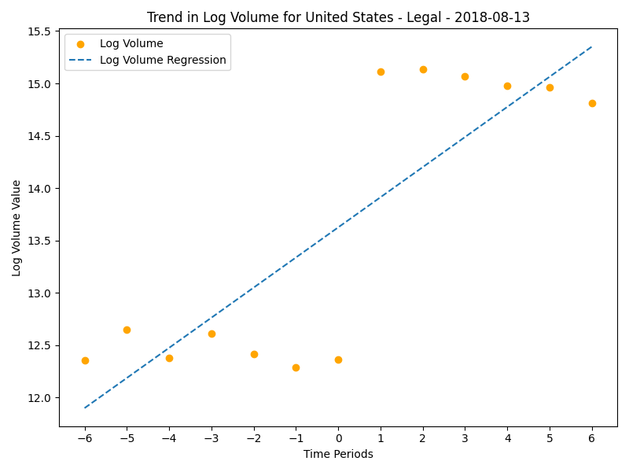
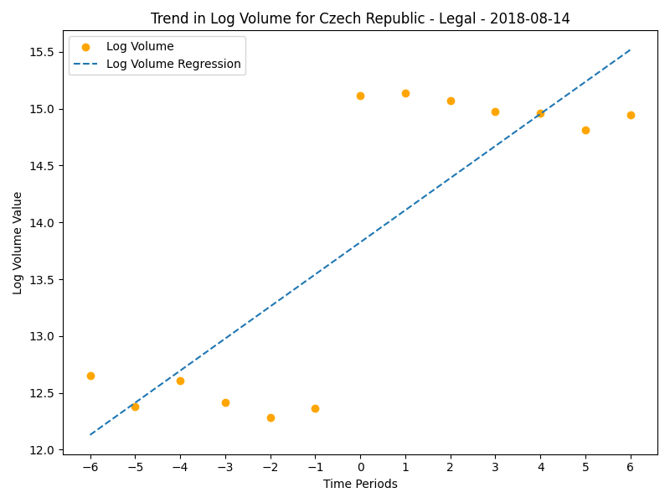
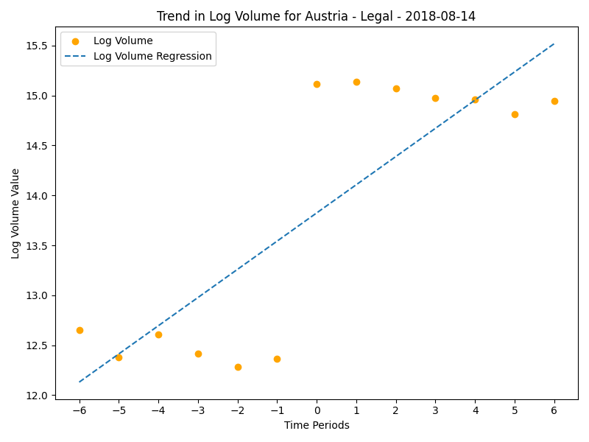

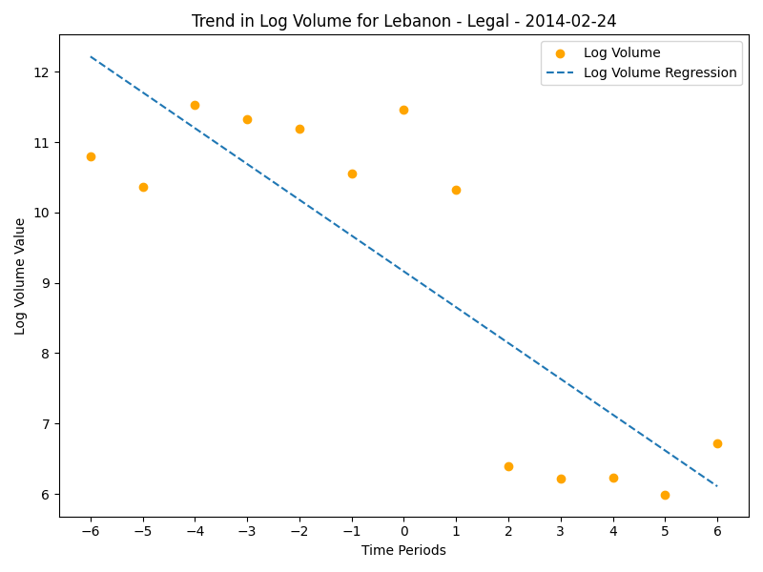

Slide 15
2014-2-24
The government of Lebanon has issued a warning discouraging the use of bitcoin and other similar systems.[71]
The government of Jordan has issued a warning discouraging the use of bitcoin and other similar systems.[71] The Central Bank of Jordan prohibits banks, currency exchanges, financial companies, and payment service companies from dealing in bitcoins or other digital currencies.[72] While it warned the public of risks of bitcoins, and that they are not legal tender, bitcoins are still accepted by small businesses and merchants.[72]

Slide 16
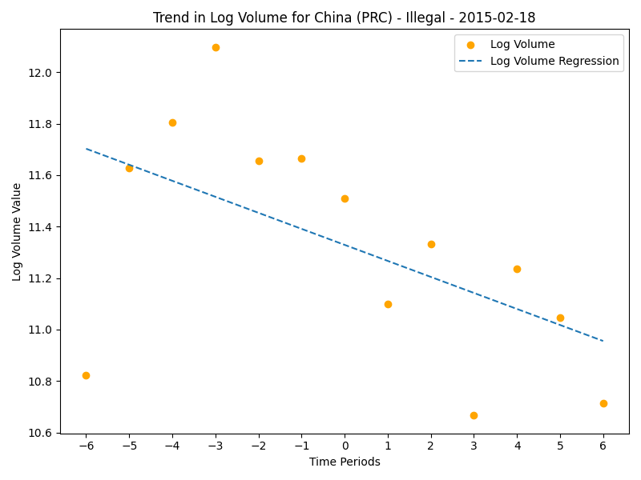
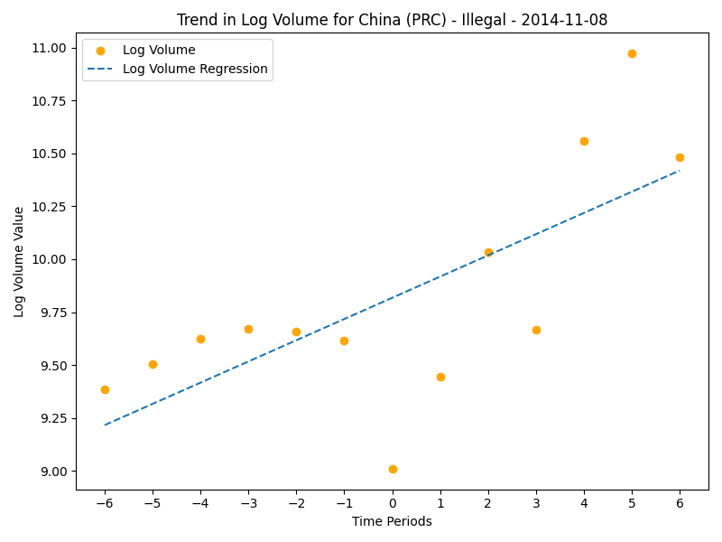
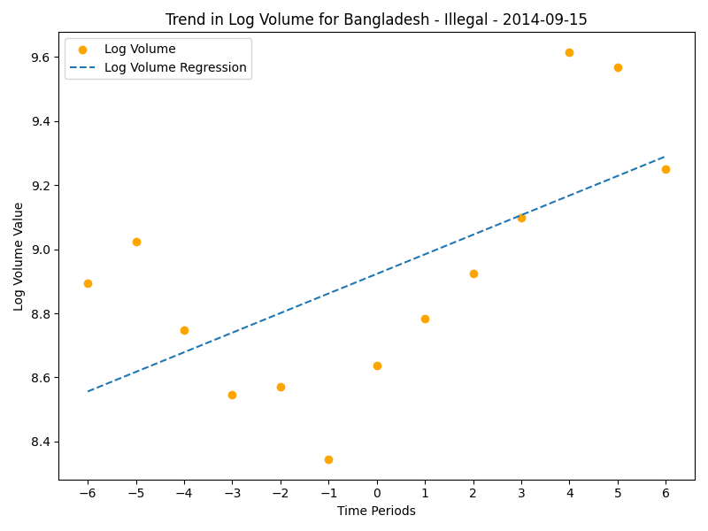


Date Not mentioned in text:
Financial institutions are not allowed to facilitate bitcoin transactions.[14] Regulation prohibits financial firms holding or trading cryptocurrencies.[8]: China On 5 December 2013, People's Bank of China (PBOC) made its first step in regulating bitcoin by prohibiting financial institutions from handling bitcoin transactions.[98] On 1 April 2014 PBOC ordered commercial banks and payment companies to close bitcoin trading accounts in two weeks.[99] Cryptocurrency exchanges or trading platforms were effectively banned by regulation in September 2017 with 173 platforms closed down by July 2018.[100] In early 2018 the People's Bank of China announced the State Administration of Foreign Exchange led by Pan Gongsheng would crack down on bitcoin mining.[101][102] Many bitcoin mining operations in China had stopped operating by January 2018.[100] A complete ban on cryptocurrency trading and mining was put into effect on 24 September 2021.[103]
Financial institutions are not allowed to facilitate bitcoin transactions.[14] In September 2014, Bangladesh Bank said that "anybody caught using the virtual currency could be jailed under the country's strict anti-money laundering laws".[78] In 2021 the Bangladesh Bank said that cryptocurrency transactions or trade should be deemed as crimes if they involve money laundering or terror financing.[79]

Slide 17
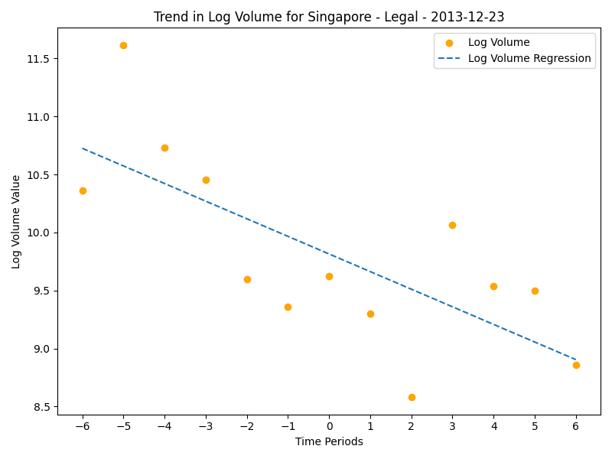
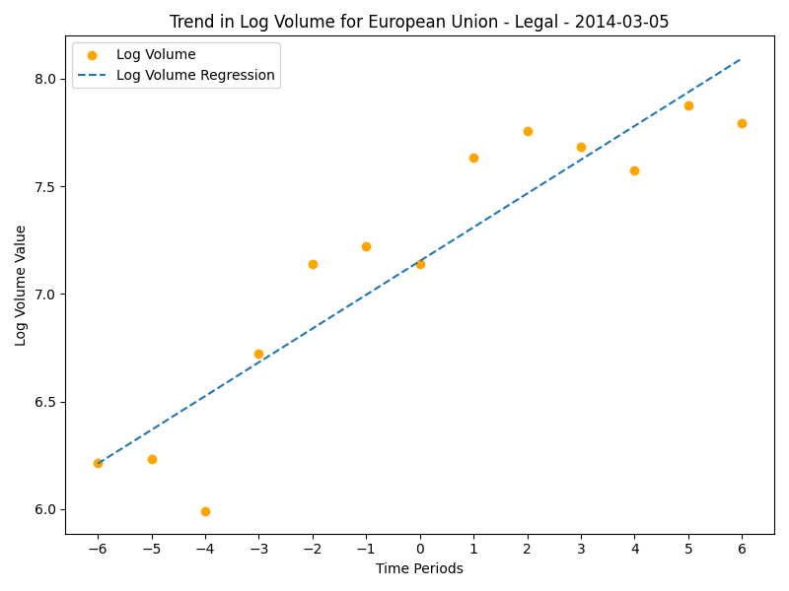
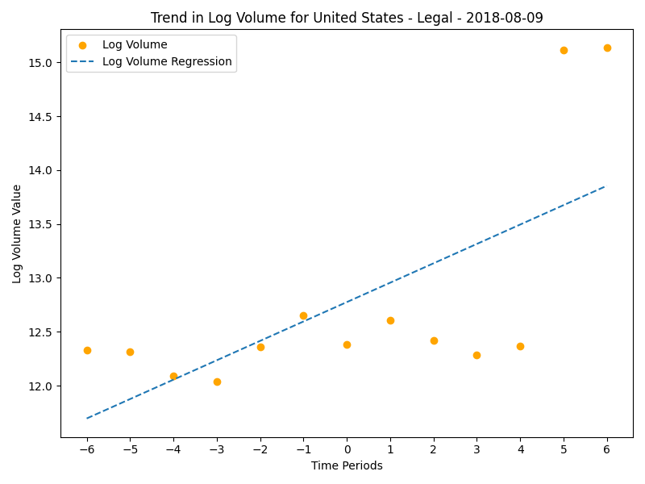

In December 2013, the Monetary Authority of Singapore reportedly stated that "[w]hether or not businesses accept bitcoins in exchange for their goods and services is a commercial decision in which MAS does not intervene."[3]: Singapore On 22 September 2013, the Monetary Authority of Singapore (MAS) warned users of the risks associated with using bitcoin stating "If bitcoin ceases to operate, there may not be an identifiable party responsible for refunding their monies or for them to seek recourse"[119] and in December 2013 stated "Whether or not businesses accept bitcoins in exchange for their goods and services is a commercial decision in which MAS does not intervene"[120] In January 2014, the Inland Revenue Authority of Singapore issued a series of tax guidelines according to which bitcoin transactions may be treated as a barter exchange if it is used as a payment method for real goods and services. Businesses that deal with bitcoin currency exchanges will be taxed based on their bitcoin sales.[121] In April 2019, the MAS referred to bitcoin as a digital payment token for purposes of the Payment Services Act.[122]
On 23 December 2013 the Slovenian Ministry of Finance made an announcement[144] stating that bitcoin is neither a currency nor an asset. There is no capital gains tax chargeable on bitcoin, however bitcoin mining is taxed and businesses selling goods/services in bitcoin are also taxed.
Bitcoin businesses in Switzerland are subject to anti-money laundering regulations and in some instances may need to obtain a banking license.[145] On 5 December 2013, a proposal was put forth by 45 members of the Swiss Parliament for digital sustainability (Pardigli), that calls on the Swiss government to evaluate the opportunities for utilization of bitcoin by the country's financial sector.[146] It also seeks clarification on bitcoin's legal standing with respect to VAT, securities and anti-money laundering laws.[147] In response to the parliament postulates, the Swiss Federal Council issued a report on virtual currencies in June 2014.[148] The report states that since virtual currencies are not in a legal vacuum, the Federal Council has concluded that there is no need for legislative measures to be taken at the moment. In 2016, Zug added bitcoin as a means of paying city fees, in a test and an attempt to advance Zug as a region that is advancing future technologies.[149] Swiss Federal Railways, government-owned railway company of Switzerland, sells bitcoins at its ticket machines.[150] In 2018, FINMA stated that it would take a "balanced approach" towards the cryptocurrency industry and allow "legitimate innovators to navigate the regulatory landscape". By June 2021, a record number of 100 Exchange Traded Products (ETP) and crypto structured products were offered on the SIX Swiss Exchange with a total trading value of CHF 4.6 billion.[151]

Slide 18
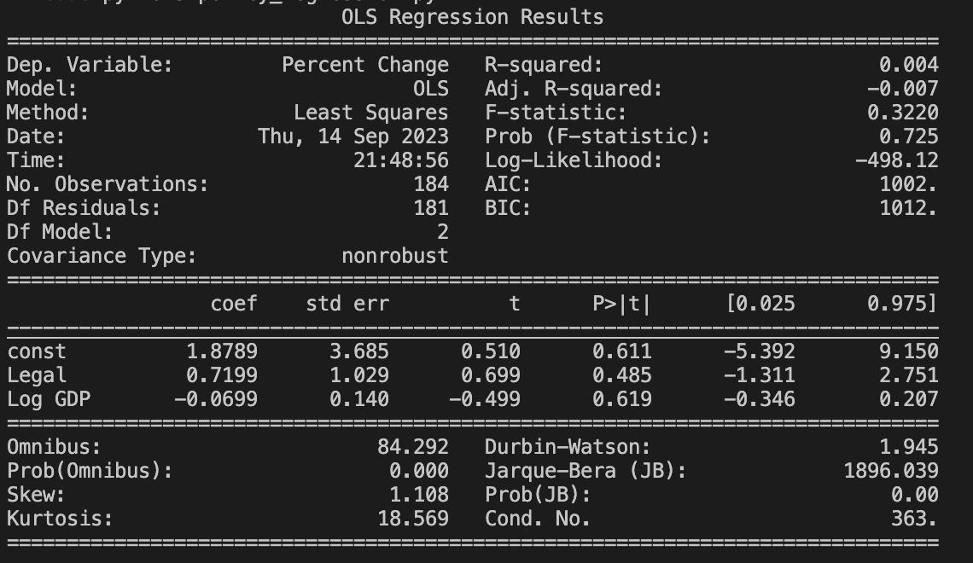
9/15
regression analysis
y = change in price ( 5 days before and after)
x = binary (legal vs illegal), log GDP of that country in that time period

Slide 19
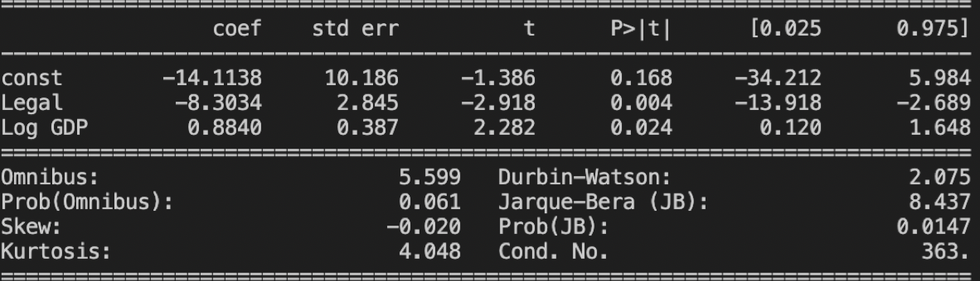
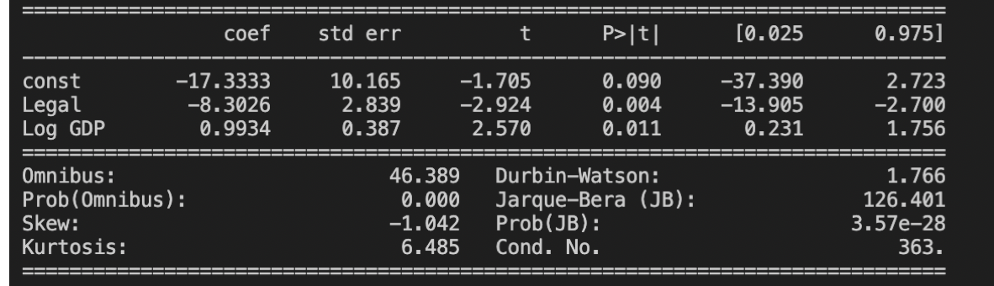
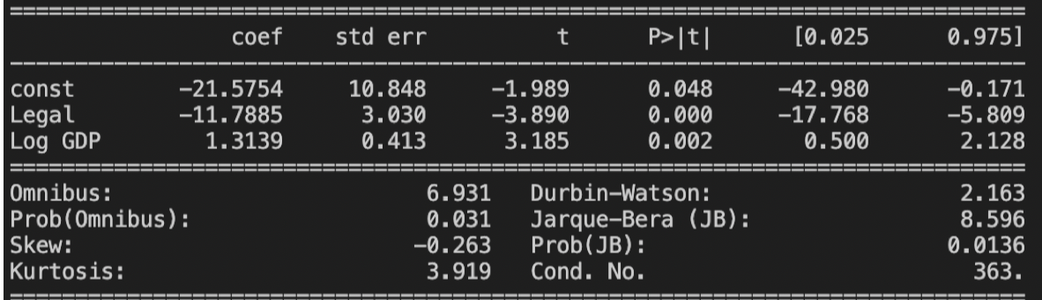
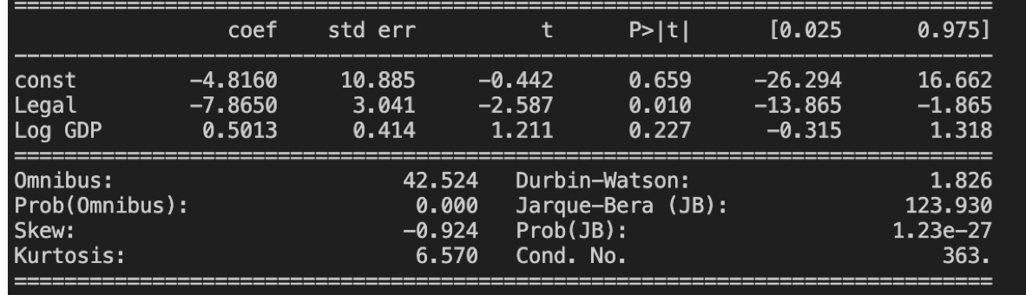
9/22
regression analysis
y = change in log price/volume
x = binary (legal vs illegal), log GDP of that country in that time period
 | t0=-30, t1=5 | t0=-20, t1=5 | t0=-10, t1=5 | t0=-5, t1=5
Log price | p>0.1 | p>0.1 | p>0.1 | p>0.1
Log volume

Slide 20
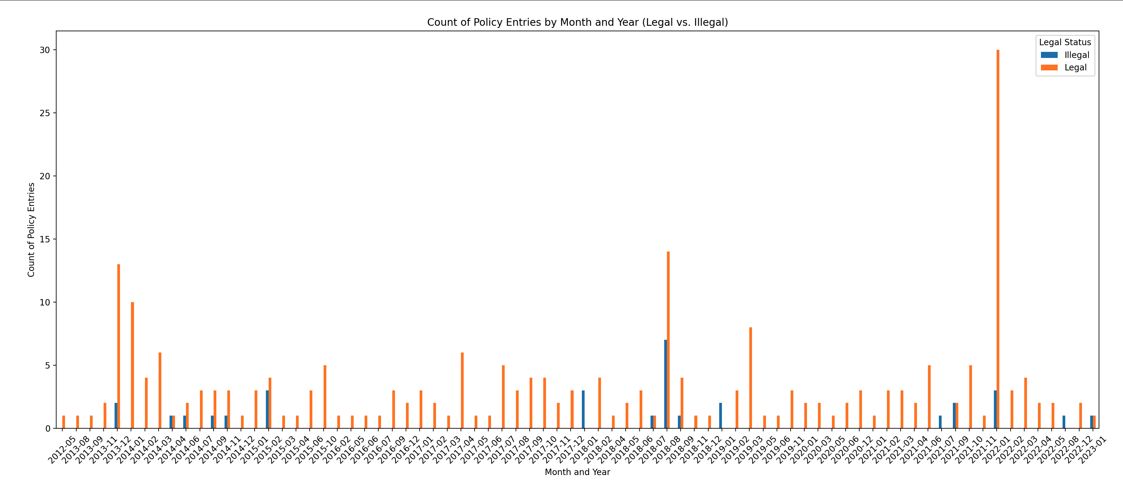
10/3 distribution of crypto legality policy dataset https://www.dropbox.com/scl/fi/vv6k0c28py28uque1z9ua/Research_result_3.14.csv?rlkey=7e3y4ob4g46a985z6n5gt240v&dl=0

